Slide 1
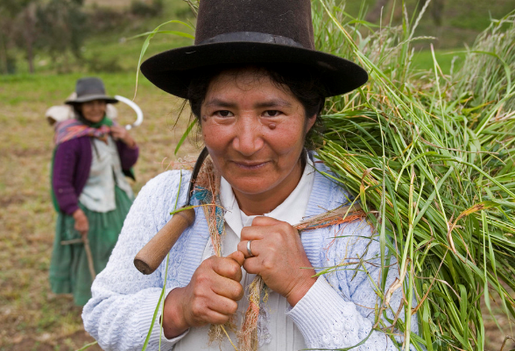
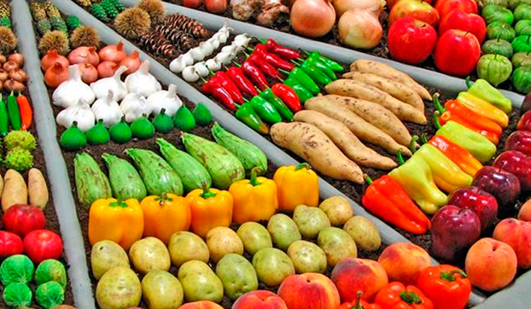
Transition from
Commodity Boom to
Consumption Led Agriculture Growth:
Opportunities for Latin America
Juergen Voegele
Senior Director
Agriculture Global Practice
World Bank Group

Slide 2

Major Global Trends

Slide 3
World food demand will be 40% higher by 2050
MORE FOOD
+17%
+47%
+155%
+51%
+27%

Slide 4
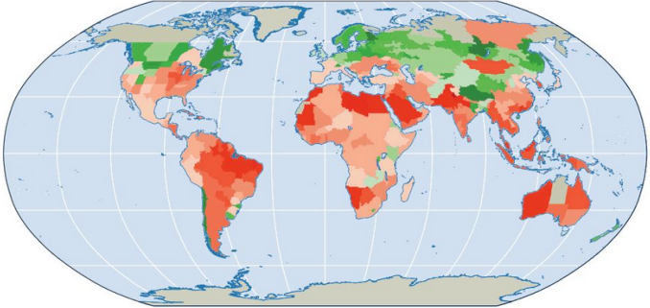


Climate Change Impacts on Food Production
Yield Collapse?
(Projected Percentage Changes in Yields of 11 Major Crops from 2046-2065, compared with 1996-2005)
Müller et al. 2009.
Notes:
Source: Müller, C., A. Bondeau, A. Popp, K. Waha, and M. Fader. 2009. “Climate Change Impacts on Agricultural Yields.” Background note for the WDR 2010.
The coloring in the figure shows the projected percentage change in yields of 11 major crops (wheat, rice, maize, millet, field pea, sugar beet, sweet potato, soybean, groundnut, sunflower, and rapeseed) from 2046 to 2055, compared with 1996–2005.
The yield-change values are the mean of three emission scenarios across five global climate models, assuming no CO2 fertilization (a possible boost to plant growth and water-use efficiency from higher ambient CO2 concentrations).
Large negative yield impacts are projected in many areas that are highly dependent on agriculture.

Slide 5
Notes:
Over 2008-2011, El Nino and La Nina related global grain shocks caused an estimated loss of around 25 million metric tons of major food grains per year.
France produces 39 million MT of wheat per year, Canada – 29 m MT, Ukraine – 24 m MT.

Slide 6

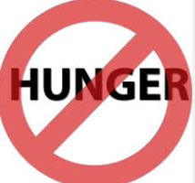
Producing (and eating) the right food
BETTER FOOD
?
?
?
Notes:
Today, 795 million people are not meeting their minimum dietary energy needs
Over 2 billion people are overweight or obese, two-thirds of whom live in developing countries
Over 2 billion people are deficient in key vitamins and minerals, and 1 in 3 children in SSA and SAR are stunned
Too many children are not receiving what they need to reach their full potential. Their development is affected by malnutrition, lack of early stimulation and learning or by exposure to violence and neglect
One quarter of children under age five worldwide are chronically malnourished
Contaminated food impacts 1 in 10 people (and kills 420,000 people) globally each year
Impacts of malnutrition:
Vitamin A, iron, and zinc are three of the micronutrients identified by the WHO as most lacking in diets globally. Adverse effects of malnutrition are particularly strong for young children and women of reproductive age. Deleterious effects of malnutrition include low birth weight, stunting, blindness, and impairment of physical work productivity, the immune system and cognitive performance throughout one’s life.
China 2008 Milk Scandal:
Eight years ago today, sixteen infants in China’s Gansu Province were diagnosed with kidney stones. All of them had been fed milk powder that was later found to have been adulterated with a toxic industrial compound called melamine. Four months later, an estimated 300,000 babies in China were sick from the contaminated milk, and the kidney damage led to six fatalities. The Sanlu Group, one of the largest dairy producers in China, was identified as the chief culprit. But as the scandal unfolded, more Chinese dairy firms became implicated. In hindsight, it is not an overstatement that the 2008 incident is one of the largest food safety scandals in PRC history. Consumer confidence in Chinese dairy products remains extremely weak. Official media suggests that over half of the Chinese baby formula market is dominated by foreign brands, and in some cities, the share is as high as 80 percent.

Slide 7
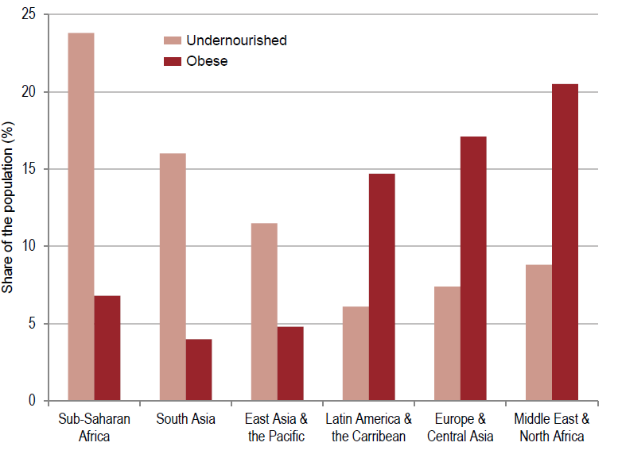
Great regional variation of the nutrition challenge
Notes:
Globally, obesity has increased to the extent that the number of overweight people now exceeds the number of underweight people worldwide. The economic cost of obesity has been estimated at $2 trillion, accounting for about 5 percent of deaths worldwide. Most 30 percent of the world’s population, or 2.1 billion people, are overweight or obese, 62 percent of whom live in developing countries.
Notes:
Source: FAO (2014). The State of Food Insecurity in the World. Rome; Ng, M. et al. (2014). “Global, regional, and
national prevalence of overweight and obesity in children and adults during 1980–2013: a systematic analysis
for the Global Burden of Disease Study 2013,” Lancet 384:766-81; UN Population Division data.
Note: For each developing country the respective obesity data from Ng et al., are weighted by the share
of the population above and below 20 years old, and within regions, by the population of each country.

Slide 8
TOMORROW – The Food System could be THE Climate Change Problem
SUST. FOOD
Projections of Global, Agriculture and Land Use Change Related Emissions towards 2050 (Gt CO₂e)
Global Emissions: 49.1 Gt
Agriculture Business As Usual
Ag. Reduces Proportional
to Other Sectors
Global Emissions:
21-22 Gt
Global Emissions:
21-22 Gt
~70%
of Total
~25%
of Total
11%
5.4 Gt LULUCF*
25%
5.4 Gt LULUCF*
6.4 Gt Agriculture
45%
9.5 Gt Agriculture
- 5.5 Gt
60% GAP
14%
4 Gt Agriculture
4 GT Agriculture
TODAY
2050 - ‘2C’ Ensuring Emission Level
WRI 2013
*Land Use, Land Use Change and Forestry
Notes:
This slides shows the result of a simple back of the envelope calculation that demonstrates the imperative for emission reductions in the Agriculture and broader Land Use Change Sectors.
By 2050 Agriculture and Land Use Change could represent 70% of Global Emissions – if global emissions are reduced in accordance with a 2C goal, while Agriculture were to remain in business as usual.
By 2050, Agriculture will have to reduce its emissions intensity by 60% if it is to maintain its footprint in parallel with overall emissions reductions. This assumes emissions from Land Use Change will have fallen to zero.
Scientists calculate that in order to stay below 2C global warming, by 2050, the World will have a ‘permissable’ greenhouse gas emission budget of about 21-22 Giga Tons of CO2 per year for all sectors combined.
If agriculture and land use change were to continue on their current path (Business as Usual), they are projected to reach about 15 Giga Tons of CO2 equivalent by 2050.
A comparison between the two estimates yields that Agriculture and Land Use Change under Business as Usual would together dominate global emissions (70%!) by 2050 – leaving only 30% for all the other sectors combined.
Even if Land Use Change were to be reduced to 0 by 2050, Agriculture would need to reduce its emission intensity by 60% if it were to reduce its emission in accordance with other sectors (keep the relative share of Agriculture of total emissions constant).

Slide 9
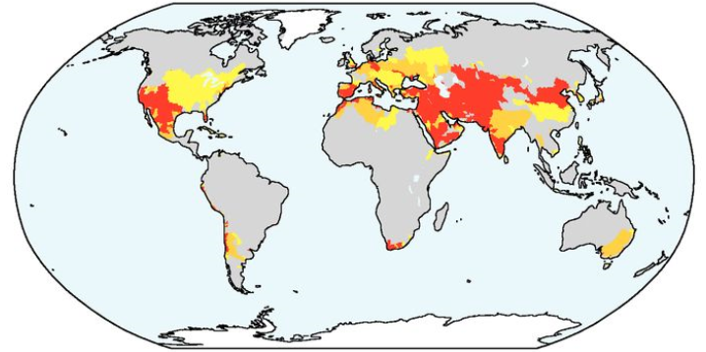
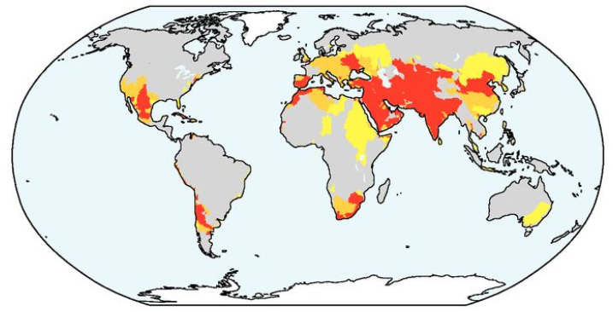
Rising water stress for food production by 2050
2000
2050
Severity level (water exploitation rate):
No (<0.1)
Low (0.1-0.2)
Medium (0.2-0.4)
Severe (>0.4)
Notes:
Many water basins are projected to come under severe water stress by 2050, mainly as a result of growing water demands
Under the Baseline, the number of people living in river basins under severe water stress is projected to more than double between 2000-2050, reaching 3.9 billion people, or more than 40% of the world’s population
Already today, 28% of all croplands face high to extremely high levels of water stress. By 2050, watersheds in South Asia and the Middle East, and large part of China and North Africa will fall under severe water stress.
Today, 17-20% of ag land is irrigated but irrigated area accounts for ~40% of global food production
Ag uses 70% of global water withdrawals, and 80-90% of global water consumption (net of evaporation)
Irrigation dominates water use consumption in all regions worldwide and 70% of global irrigated area experiences periodic water shortages (NPAS 2016); and groundwater provides almost half of all agricultural water use (much of it non-sustainable abstraction of groundwater)
The Global Food System increasingly relies on unsustainable groundwater use and aquifers overexploitation.

Slide 10

FOR LCR
Notes:
Key messages for LCR:
For LCR, this means:
Economic opportunities given LCR’s status as major food exporter, and advanced agribusiness sector
Ability to contribute to making agriculture solution to the climate change problem – with the need to focus on livestock sector emissions given the high production levels of meat for export, and high and increasing local demand for animal products
The need to focus on nutrition – even if hunger is not a major problem – but the rising obesity trend is alarming
Promote LCR’s role as innovator – and spread the fruits of ag research and innovation from LCR in Africa and Asia
The resources are available, if we shift to climate-smart investments, and improve the food system’s efficiency

Slide 11
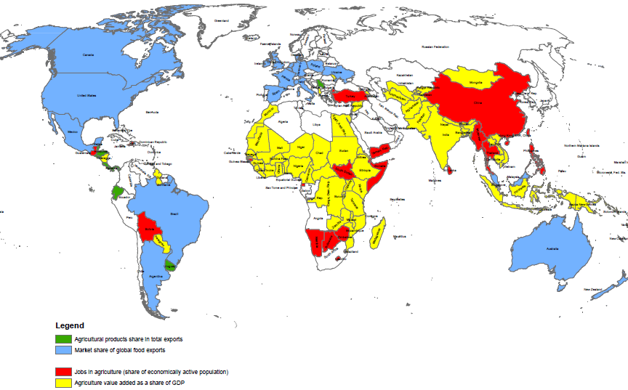
Latin America – key to global food trade & exports
Agriculture products share in total exports
Market share of global food exports
Jobs in agriculture (share of economically active population)
Agriculture value added as share of GDP
Notes:
In 64 countries agriculture contributes more than 14% of GDP, most of them in SSA, South and East Asia, and ag is a main source of jobs in 67 countries (more than 30% of the jobs)
This map shows where ag is important from different perspectives—so in countries shaded yellow it may be important according to up to 4 dimensions and so on (ag value added, then also jobs, then also global market share, & ag exports).
In LCR countries shaded blue, it is important from the global trade perspective; in red—ag value added and jobs, and green—share in total exports of a country
Note on the map: Countries’ agriculture is highlighted as “important” based on notional thresholds: if ag. value added >14% of GDP, jobs>30% of econ active population, global food export share>1%, ag exports>20% of total exports. The purpose of this figure is to show the relative importance of LCR agriculture from the global/food trade perspective.

Slide 12
Move Jobs up the Food System
Low Income: e.g. African countries
≈ 80% of all jobs
Farming
91%
Food manuf./
industry
3%
Food services
6%
Middle Income: e.g. Brazil
≈ 30% of all jobs.
Farming
49%
Food manuf./
industry
25%
Food services
26%
High Income: e.g. US
≈ 10% of all jobs
Farming
21%
Food manuf./
industry
13%
Food services
66%
Notes:
More food system jobs will be in food services and food manufacturing
In low income countries the food system provides the most jobs, most of which are on-farm. At early stages of structural transformation, with a shift away from subsistence agriculture, consumer demand for manufactured goods and services comes from higher agricultural incomes with higher agricultural productivity growth initially driving incomes and jobs in the economy. Many of the manufacturing and services jobs are related to agriculture and form part of the food system. For example, household survey based estimates from six East African Countries (Ethiopia, Malawi, Mozambique, Tanzania, Uganda, Zambia) show that the food system accounts for 83 percent of the total number of jobs. Within the food system farming (own and wage labor) accounts for 91 percent of jobs, food manufacturing 3 percent, and food services (marketing, transport, food preparation away from home) 6 percent. Jobs outside the food system are a relatively small share of the total at 13 percent. In these countries a large share of household budgets are spent on food, and estimated income elasticities for food consumption are relatively high (above 0.8). Higher farm incomes stimulate demand for local manufacturer products and services thereby stimulating growth in these sectors, many of whom are local informal producers of non-tradable products and rely on local demand for their income.
In middle income countries the food system continues to provide a large share of jobs, with a more even share of on-farm jobs and off-farm food related jobs in manufacturing and services. As per capita incomes increase, the agribusiness sector grows faster than primary agriculture and the ratio of food processing to agricultural value added increases. Middle income countries have greater consumer demand for and household expenditures on higher value agricultural products and processed foods. As a result the agribusiness subsector servicing this demand often provides as many jobs as the farming sub-sector. For example, in Brazil the food system accounts for about 30 percent of the total number of jobs. Within the food system, farming accounting for 49 percent of jobs, agroindustry for 25 percent, and food distribution and services 26 percent^{[1]}. There is however wide variation across countries. For example, the agribusiness sector in India is small relative to other middle income countries.
In high income countries the food system provides a smaller share of jobs, most are in related services, with a smaller share in farming and food manufacturing. As per capita incomes increase further, the composition of consumption shifts to a larger share of spending on non-food items. For example, in the US about 10 percent of disposable income is spent on food, with half the expenditures for food in the home, and half of food away from home (in restaurants). The income elasticity for food consumption is lower than in middle-income countries (at about 0.35). Correspondingly agriculture and its related industries and services provide about 10 percent of US employment. Within the food system, farming provides 21 percent of jobs, agrifood related manufacturing provides 13 percent of jobs, and food services provide 66 percent of jobs. In France, food accounts for about 14 percent of household spending, and the agrifood sector accounts for 18 percent employment―driven by both local and export demand.
^{[1]} V. R. Moreira, R. Kureski, C. P. da Veiga, “Assessment of the Economic Structure of Brazilian Agribusiness” The Scientific World Journal Article ID 7517806, 10 pages, 2016. doi:10.1155/2016/7517806.

Slide 13




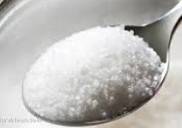
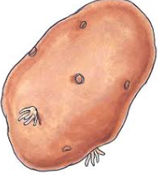
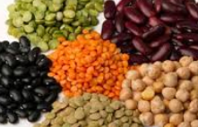
Demand for meat & dairy will increase the most
DIFFERENT FOOD
Source: World Bank (2015) based on Bruinsma and

Slide 14
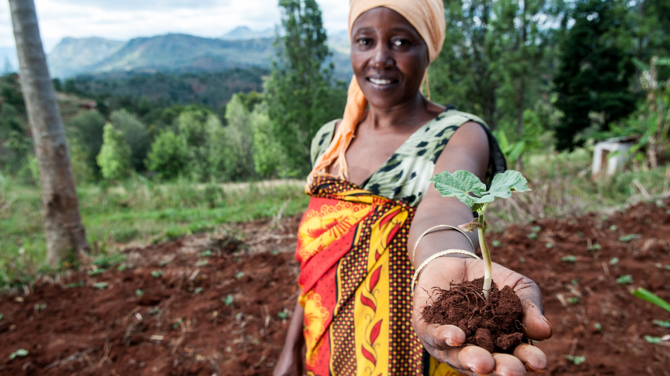

BOOST CLIMATE-SMART AGRICULTURE, SECURE THE TRIPLE WIN
Increased productivity
Enhanced resilience
Reduced emissions
14
Notes:
Background Brief for Slide on Climate-Smart Agriculture (Slide 16)
Scaling-up climate-smart agriculture is a key aspect to sustainable growth and fostering resilience. Both are critical ingredients in the march to end poverty and boost shared prosperity.
By 2030 a 1.5°C temperature rise could lead to about 40 percent of present maize cropping area in Sub-Saharan Africa being no longer suitable for current cultivars (World Bank, 2013).
By 2030, food demand in Sub-Saharan Africa is projected to increase by 55 percent. Globally it will rise by about 20 percent, with the need to feed 8.5 billion people every day (World Bank 2015).
By 2050, projecting past trends, agriculture and other land use changes alone would comprise 70 percent of total allowable emissions to cap temperature rises to 2°C (World Resources Institute 2013).
We need to boost climate-smart agriculture to secure the triple-win of a simultaneous increase in productivity, enhanced resilience, and reduced emissions. This is gradually happening.
Climate-smart agriculture integrates climate change into agriculture policy by adopting a strategic systems approach. It asks: which set of investments and policies together can achieve the required outcomes across productivity, resilience and emissions at the system level?
Key knowledge products such as our Climate-smart Agriculture Country Profiles disseminate these diverse sets of best bet investment opportunities to our client countries. These include:
Agroforestry and silvo-pastoral systems―adding trees―in coffee and mixed farming systems in Colombia, Kenya, Mexico, and Peru;
Intercropping of two different crops in the same field in Argentina, Kenya, and Peru;
Rotating crops in bean and maize systems in Rwanda.
The World Bank has committed to make its agriculture project pipeline 100% climate-smart by 2018. While this doesn’t mean that every project will have climate-smart components, all projects will be screened for opportunities to do so.
Governments around the world are increasingly committed. Most countries included agriculture in their Intended Nationally Determined Contributions [INDCs] to climate adaptation and mitigation.
126 of 134 countries included agriculture under adaptation in their INDCs and 119 of 162 included it under mitigation.
Over 30 countries specifically mention Climate-Smart Agriculture.
There is also a broader global movement with the Global Alliance on Climate-Smart Agriculture now operational and regional alliances established in North America, Africa, South Asia, and Central America.
The Global Alliance for Climate-Smart Agriculture is a voluntary, farmer-led, multi-stakeholder, coalition. It has set itself the aspirational goal of enabling 500 million farmers to practice climate-smart agriculture by 2030.
Regional alliances work with multilateral organizations such as the African Union or the Common Market for Eastern & Southern Africa (COMESA) on many fronts including policy, capacity building, and private sector linkages.
The private sector is also increasingly active: The World Business Council for Sustainable Development (WBCSD) has brought together major food companies for an ambitious Climate-smart Agriculture Action Plan aiming to make 50 percent more food available and strengthen the climate resilience of farming communities whilst reducing agricultural and land-use change emissions by at least 50 percent.
Successful investments are being delivered on the ground.
In Vietnam, 33,000 farmers have switched from flood irrigation to the climate-smart practice Alternative Wetting and Drying [AWD].
Productivity has increased by 5-10 percent, input costs have been reduced by 20 percent.
Resilience: Water use for irrigation has been reduced by 20 percent.
Emissions: Methane emissions, a potent greenhouse gas, decline by up to 30 percent.
In Uruguay, placing sustainability at the center of its agriculture agenda has allowed the country to quadruple agricultural production within a decade.
Productivity: Close to 3 million hectares of land - about 20% of total arable land - are now under sustainable land management practices.
Resilience: An advanced agriculture information system allows farmers to access detailed climate information to plan and mitigate climate risks.
Emissions: Low carbon technologies save more than 8 million tons of carbon per year.
In Niger, together with the government, we recently launched our first dedicated Climate-smart Agriculture project in Africa, keeping productivity, resilience and mitigation in our sights right from the first day of project design.
Productivity: Investments in technologies and technology transfer are expected to achieve a 50 percent increase in the productivity of staple food crops.
Resilience: Project beneficiaries will adopt improved agronomic and management practices.
Emissions: Mitigation co-benefits will be achieved through reductions in the greenhouse gas emission intensity per unit of production (per liter of milk for example).
We are committed to scaling-up our support in the World Bank. We stand ready to support our client countries and have made the following commitments:
We will increase the share of our agriculture lending that delivers adaptation and mitigation co-benefits to 30-35%.
We will screen for climate risks and account for GHG emission impacts in all our agriculture projects.
We will accompany our investments with the requisite analytics to ensure the resources deliver maximum impact. To achieve this we have committed in our Climate Change Action Plan to develop at least 40 data and evidence driven Climate-smart Agriculture Profiles and Investment Plans that will allow countries to prioritize where it really matters.
We will scale up Climate-smart agriculture investment globally and especially in Africa where vulnerability is the greatest. Through our Africa Climate Change Business Plan, we aim to facilitate the adoption of Climate-smart agriculture practices by 10 million farmers by 2023.

Slide 15
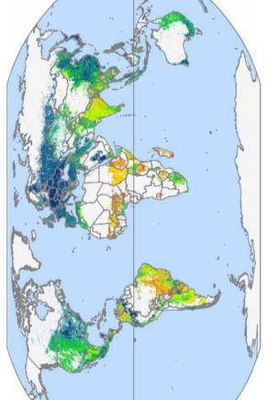
Efficiency of Livestock Systems Varies Greatly
Emissions Intensity of Livestock Production
Across Regions
(Kg of CO₂e per edible unit of protein)
Distribution of Producers along Emission Intensity
Within a Given Region
(Emission intensity per unit of production)
The Top 10% most efficient producers in every region are already producing highly efficiently using existing technologies.
10%
Quantity of Producers
90%
HIGH EFFICIENCY
LOW EFFICIENCY
Emissions Intensity
THE TOP 10% MOST EFFICIENT PRODUCERS
PRODUCERS THAT COULD BE EQUALLY EFFICIENT
There is ample potential to increase the efficiency and
emissions intensity of livestock systems both across and within regions.
Based on results of the GLEAM Model, FAO 2013
Notes:
Map and approach from FAO (2013) Tackling Climate Change Through Livestock.

Slide 16
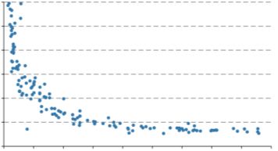
What if we made all livestock farmers as efficient as the Top 10%?
In Livestock, Higher productivity ⇒ Lower Emission Intensity
Lowering emissions intensity also contributes to food security.
In Africa higher productivity would have major impact on poverty.
Higher incomes for farmers
Healthier animals
Biodiversity conservation due to reduced land pressure
Example: Dairy
Below 2000 kg milk/cow/year, productivity increases correlate with very significant reductions in emissions intensity.
PRODUCTIVITY
RESILIENCE
Emissions (kg CO₂-eq/kg Milk)
2000 kg milk/cow/year
Milk Production per Cow
EMISSIONS
Using only currently available technologies:
Feeding practices,
Animal husbandry
Health management
Potential for reduction of livestock emissions if all producers became as efficient as the Top 10%:
- 1.8 Gt CO₂e/yr in 2010
> 3 Gt CO₂e/yr in 2050
-30%
Global Livestock Emissions
Based on results of the GLEAM Model, FAO 2013, Extrapolations
Notes:
Graphic and data from FAO (2013) Tackling Climate Change Through Livestock.
Productivity:
- Blue dots represent country’s livestock systems. Curve shows that improved milk production per cow is associated with much lower emission intensity, particularly under the productivity level of 2000kg milk per cow per year.
- The major impact on poor in Africa is in relation to the additional milk production achievable, and associated income.
Resilience:
- Income is a key piece of the resilience story, as income can help build assets and generate savings – which can act as a buffer when shocks occur.
Emissions:
- Approach and assessment based on FAO (2013) Tackling Climate Change Through Livestock.
In addition, an extrapolation towards 2050, assuming current trends to continue (a projected livestock production increase of 82%, resulting in almost 11 Gt by 2050) and a reduction of 30% from all producers becoming as efficient as the Top 10%.

Slide 17




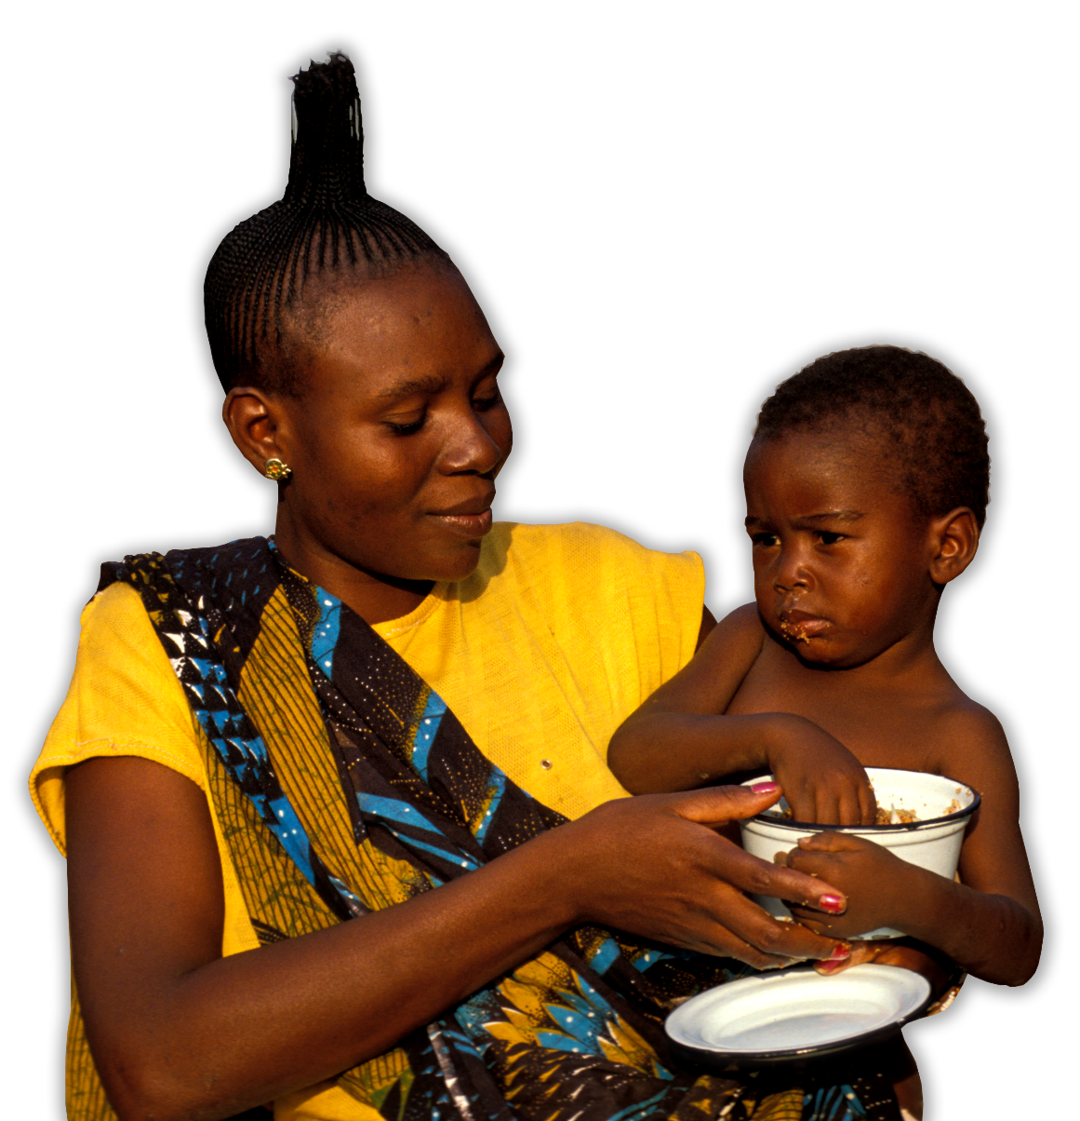




MORE, HEALTHIER, SAFER, SUSTAINABLE and
affordable
food
Notes:
Key messages:
Currently, 2 billion people are micronutrient deficient. We need to ensure improved dietary diversity.
Women’s empowerment is critical to enhance household nutritional outcomes as women are the critical link between agriculture and nutrition

Slide 18
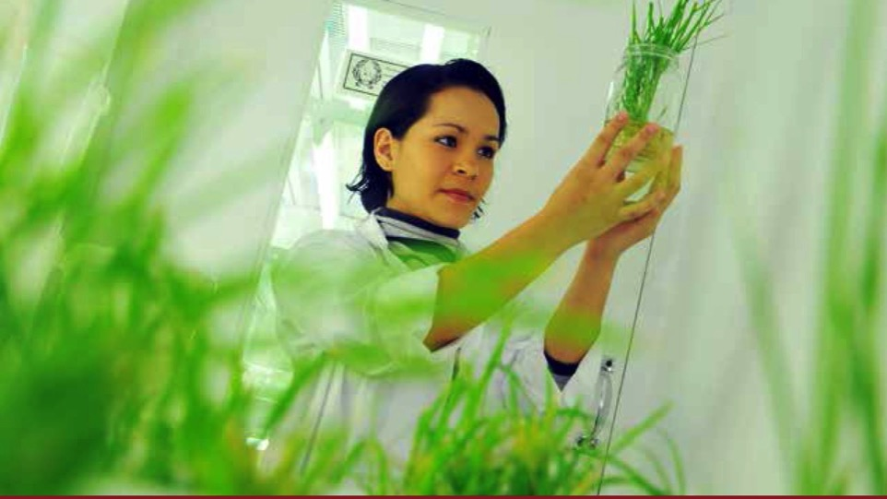
MORE AGRICULTURAL INNOVATION TO TACKLE KEY CHALLENGES
Shift agriculture from climate problem to solution
Reduce micronutrient deficiencies
Accelerate uptake of technologies to end stunting
18
Notes:
Agriculture and land use change accounts for about a quarter of global emissions. Under “business-as-usual” agriculture emissions will rise to 70 percent of allowable emissions needed to cap temperatures rises to 2^{O}C by 2050.
Agricultural must shift from being part of the climate problem to becoming a major part of the solution. Key research questions include: How can we eliminate GHG emissions from rice production? How can we reduce ruminant emissions even as demand for meat increases?
We must focus on reducing micronutrient deficiencies. Over 2 billion people are micronutrient deficient, a key factor in child stunting. Higher atmospheric CO2, will reduce concentrations of iron, zinc, and protein in crops such as wheat, rice, and soybeans. Key research questions include: How do we preserve and enhance micronutrient content in crops with climate-change? How do we achieve multiple objectives - higher yields and nutrient content, enhanced resilience, and lower emissions – in the same plant at the same time?
The recently developed sorghum variety by Nigeria and the CGIAR – which has higher yields, more iron content and resilience to drought is beginning to answer some of these questions, but more is needed.
Critically important is the need to accelerate uptake of technologies to end stunting. Improved crop varieties and better livestock breeds will not have impact if not widely adopted. Uptake pathways are a key part of the challenge, yet are often overlooked in research programs.
Key research questions.
The food system must shift from being part of the climate problem to becoming a major part of the solution.
How can we reduce ruminant emissions even as demand for meat increases? Livestock emissions (enteric fermentation) account for one third of total emissions from agriculture. With income gains leading to higher demand for animal protein, total emissions from enteric fermentation are projected to increase by 25 percent by 2050 (FAO). How do we develop improved breeds and feed management practices to reduce ruminant emissions?
How can we eliminate GHG emissions from rice production? Rice is food for billions of people. Rice production accounts for about 9 percent of global agriculture emissions (FAO). Rice production produces methane, a greenhouse gas that is more than 20-30 times more potent than carbon dioxide.
The food system must do more to reduce micronutrient deficiencies.
How do we preserve and enhance the micronutrient content in crops with climate-change? Elevated atmospheric CO₂ levels are shown to lower concentrations of iron and zinc in wheat, rice, soybeans, and field peas. Zinc and iron deficiencies already affect about 2 billion people globally.
How do we achieve multiple objectives―higher yields and nutrient content, enhanced resilience, and lower emissions―in the same plant at the same time? The world is faced with multiple concurrent challenges―the need to feed a growing population, the acute importance of ensuring well-nourished children to allow them to compete in an increasingly knowledge intensive and digital world, and the deleterious impacts of climate change. Agricultural research programs need to lift their sights and address these challenges simultaneously.
We must accelerate the uptake of new/improved technologies
Low adoption rates are often the Achilles heel of crop and livestock breeding programs. Accelerating adoption and uptake pathways must become a critical component of development efforts to ensure impact, yet they receive insufficient attention in research programs.

Slide 19
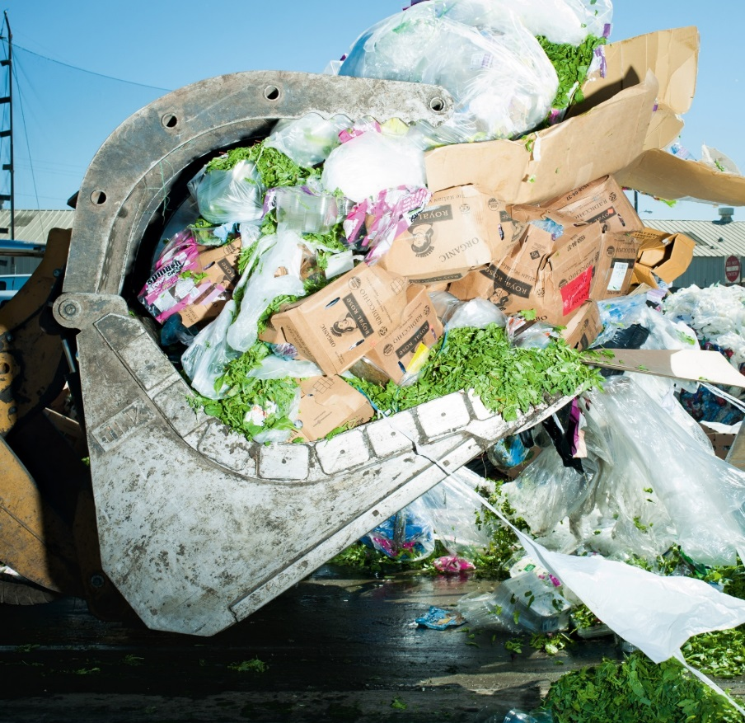

Efficiency: Meeting food demand by reducing food waste
Notes:
Over 1/3 of food wasted or lost every year (1.3 bn tons), 70% before it reaches final consumer in developing countries and the reverse in developed
Food waste at consumer level in industrialized countries (222 mn ton) is almost as high as the total net food production in Sub-Saharan Africa (230 mn ton)
Financial Times: 45% of fruit and vegetables, 30% of cereals, 20% of dairy products and meat lost or wasted every year
Eliminating all food waste and losses, would allow the world to almost meet its incremental food needs by 2030 without the need for increases in food production or productivity. There would be zero net environmental effects as no increase in food production would be needed. A less ambitious and a more realistic notional target of halving the current levels of food waste and loss would translate into an around 35-40% of the incremental food production needed by 2030 to feed the world’s projected 8.4 billion people. Thus, the environmental impacts and resource pressures could be reduced to a similar extent.

Slide 20
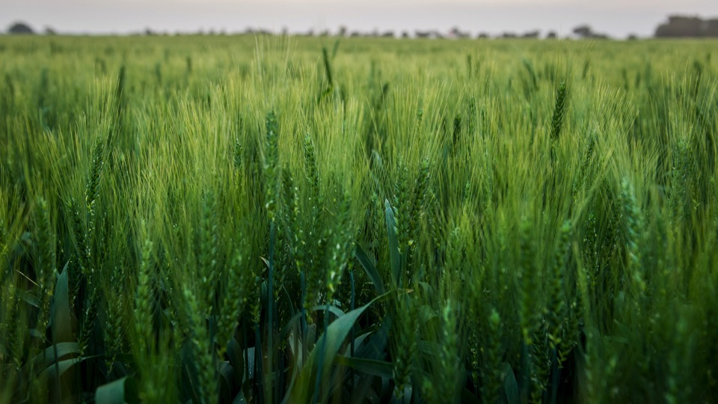
LEVERAGE FUNDS
50 COUNTRIES = $585 BILLION ANNUALLY Mainly for major cereals in many countries
Limits production of diverse foods
SOLUTIONS
Eliminate staple grain bias
Focus more on diverse diets
Invest in sustainable outcomes
20
Notes:
The OECD estimates that 50 countries have provided $585 billion per year in agricultural producer subsidies between 2013 and 2015 (OECD 2016).
Agricultural producer subsidies have more than doubled over the last 15 years. Overall direct producer support in these 50 countries has increased from $255 billion in 2000-12 to $585 billion in 2013-15. Included in the sample of 50 countries are OECD countries and emerging economies.
OECD includes: Australia, Canada, Chile, European Union [28], Iceland, Israel, Japan, Korea, Mexico, New Zealand, Norway, Switzerland, Turkey, and United States.
Emerging economies includes: Brazil, China, Colombia, Indonesia, Kazakhstan, Russia, South Africa, Ukraine, and Vietnam. A notable exclusion in the OECD estimates is India which also has significant agricultural subsidies on which this note draws some lessons.
While public support for agriculture is needed (we are not saying it should decline), and in many countries it should increase, we argue that there are more effective ways to direct $585 billion per year in producer support measures for achieving better nutritional outcomes and more sustainable food production systems. This desirable shift requires:
Removing the bias toward staple grains and enabling the shift toward more healthy, diverse diets that include fruits, vegetables, legumes, dairy and meat products.
We need to ensure support for agriculture leads to more sustainable agricultural practices.
These subsidies take the form of regulated output prices (market price supports), and direct farmer payments.
Market price supports account for about two-third of overall support, 64 percent of total subsidies ($375 billion) across the 50 countries, and take the form of regulated prices that keep domestic grain prices above world prices. This is a cost to both consumers (who pay higher prices) and taxpayers (who often pay for the state purchase of grains as the mechanism to keep prices high). These market price supports account for 45 percent of total subsidies in OECD countries, and 78 percent in emerging economies.
Direct payments to producers account for about one-third of overall support, 36 percent of total subsidies (or $210 billion), provided in the form direct budgetary payments to producers based on various criteria such as the type of outputs produced and inputs used. These direct payments account for 55 percent of total subsidies in OECD countries, and 22 percent in emerging economies.
Contrary to popular perception, most of the increase in producer subsidies over the last 15 years has been in developing countries. Agricultural subsidies are often viewed as a developed country or OECD country phenomena. Indeed, historically, developing countries have tended to significantly tax agriculture, and in 2000-02 emerging economies only accounted for 4 percent of subsidies across the 50 countries. However, by 2013-15 this share increased to almost 60 percent.
The reasons these subsidies were initially introduced includes concerns about staple grain self-sufficiency, and the rising farm and non-farm income gaps that emerge in early stages of structural transformation. A common theme on the composition of subsidies has been a bias towards staple grains.
We need to learn lessons from staple crop-focused polices of the green revolution in Asia – which led to significant needed declines in calorie deficiencies and widespread hunger, but had less impact on micronutrient deficiency and child stunting. Public support (output price support, fertilizer and credit subsidies, grain procurement for food security stocks, and irrigation infrastructure (primarily for rice)) focused primarily on the production of staple grains. As a result:
Yields of wheat, rice, and maize more than doubled, production area expanded, calorie deficiency declined.
Traditional non-staple crops such as pulses and legumes tended to be crowded out of production contributing to slower declines in micronutrient deficiency.
Prices of staple foods (e.g. rice and wheat) declined relative to the price of micronutrient rich foods (e.g. vegetables, pulses) in much of Asia making staple food relatively more affordable. The induced substitution effects led to more calorie-rich, but less diverse, and micronutrient rich foods (Gomez at al, 2013).
In India, the increasing price of legumes has been associated with a consequent decline in pulse consumption across all income groups (Kataki, 2002)
In some cases, traditional crops that were a source of critical micronutrients (such as iron and zinc) were displaced in favor of higher value staple crops.
With the public sector focus on staple grains, markets for non-staple crops are poorly developed – having received little investment in transport systems, cold storage systems, and information systems that allow for better functioning of market for perishable products such as fruits and vegetables, and livestock products (Pingali, 2015).
Another negative consequence of subsidy programs has been the increase in unsustainable farming practices. In some cases, fertilizer subsidies have led to overuse of fertilizer with little incremental yield gains but large nitrous oxide emissions (e.g. China), and subsidized inputs and irrigation has led to declining groundwater levels and rising water contamination (e.g. India).
The European Union offers some important lessons for emerging economies – they have been shifting policies to address emerging opportunities and challenges.
In 1988-1990, 79 percent of overall EU subsidies were in the form of market price supports (price regulations), similar to emerging markets today. Since then they have shifted away from support directly linked to product prices to other less-distorting forms. These include cash transfers to producers that are delinked from the outputs they produce, or inputs they use and are more focused on addressing key challenges through provision of public goods. For example, 30 percent of direct farm payments under the EU Common Agricultural Policy require adoption of environmentally sustainable farming practices.

Slide 21
Thanks!

